Slide 1
VENUES AND LIVING IN SAN JOSE
Capstone Project - The Battle of Neighborhoods
IBM Data Science Professional Certificate

Slide 2
Agenda
Introduction/Business Problem
Data
Methodology
Results
Discussion
Conclusion
References

Slide 3
Introduction
Every year, more that 7 million Americans move to a different state within the US [1].
One of the major indicators when deciding where to move is the availability of venues that fit their needs and lifestyle.
Couples moving to a new city tend to prefer lively areas with variety of venues nearby.
Specific Business problem:
A couple is moving to San Jose and interested in finding a neighborhood with an abundance of venues nearby; especially coffee shops and sandwich joints.

Slide 4
Data
San Jose neighborhood list[2]:
Neighborhood name
Latitude and longitude data
Foursquare API:
Nearby venues name
Venue category
Latitude and longitude data … etc

Slide 5
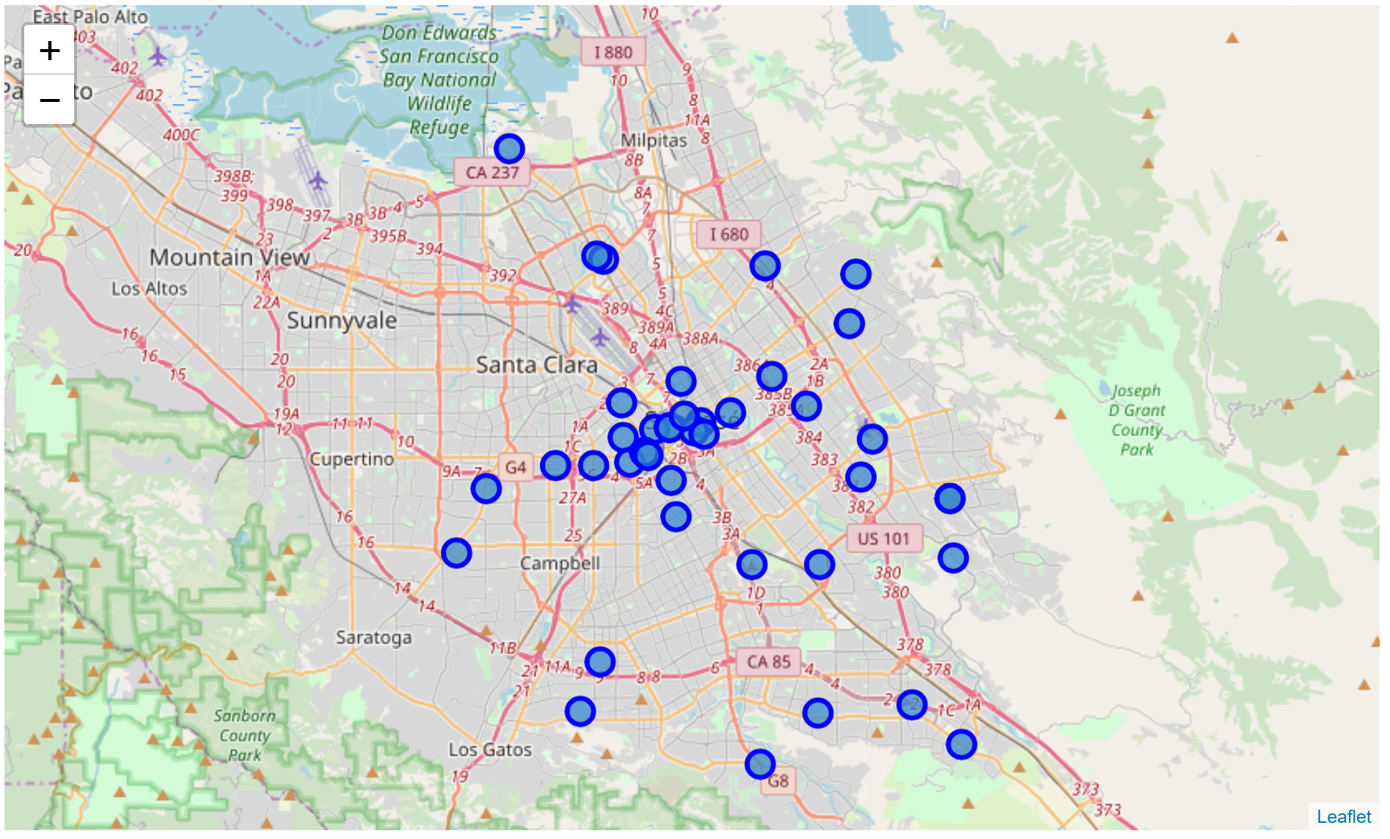
Data

Slide 6
Methodology
Retrieve nearby venues for each neighborhood from Foursquare API
Join neighborhood venues to create a list of all venues
Problem:
Redundant venues assigned to multiple neighborhoods at the same time
Reason:
Neighborhood centers retrieved from Wikipedia are too close
Solution:
Remove neighborhoods that cause redunducy

Slide 7
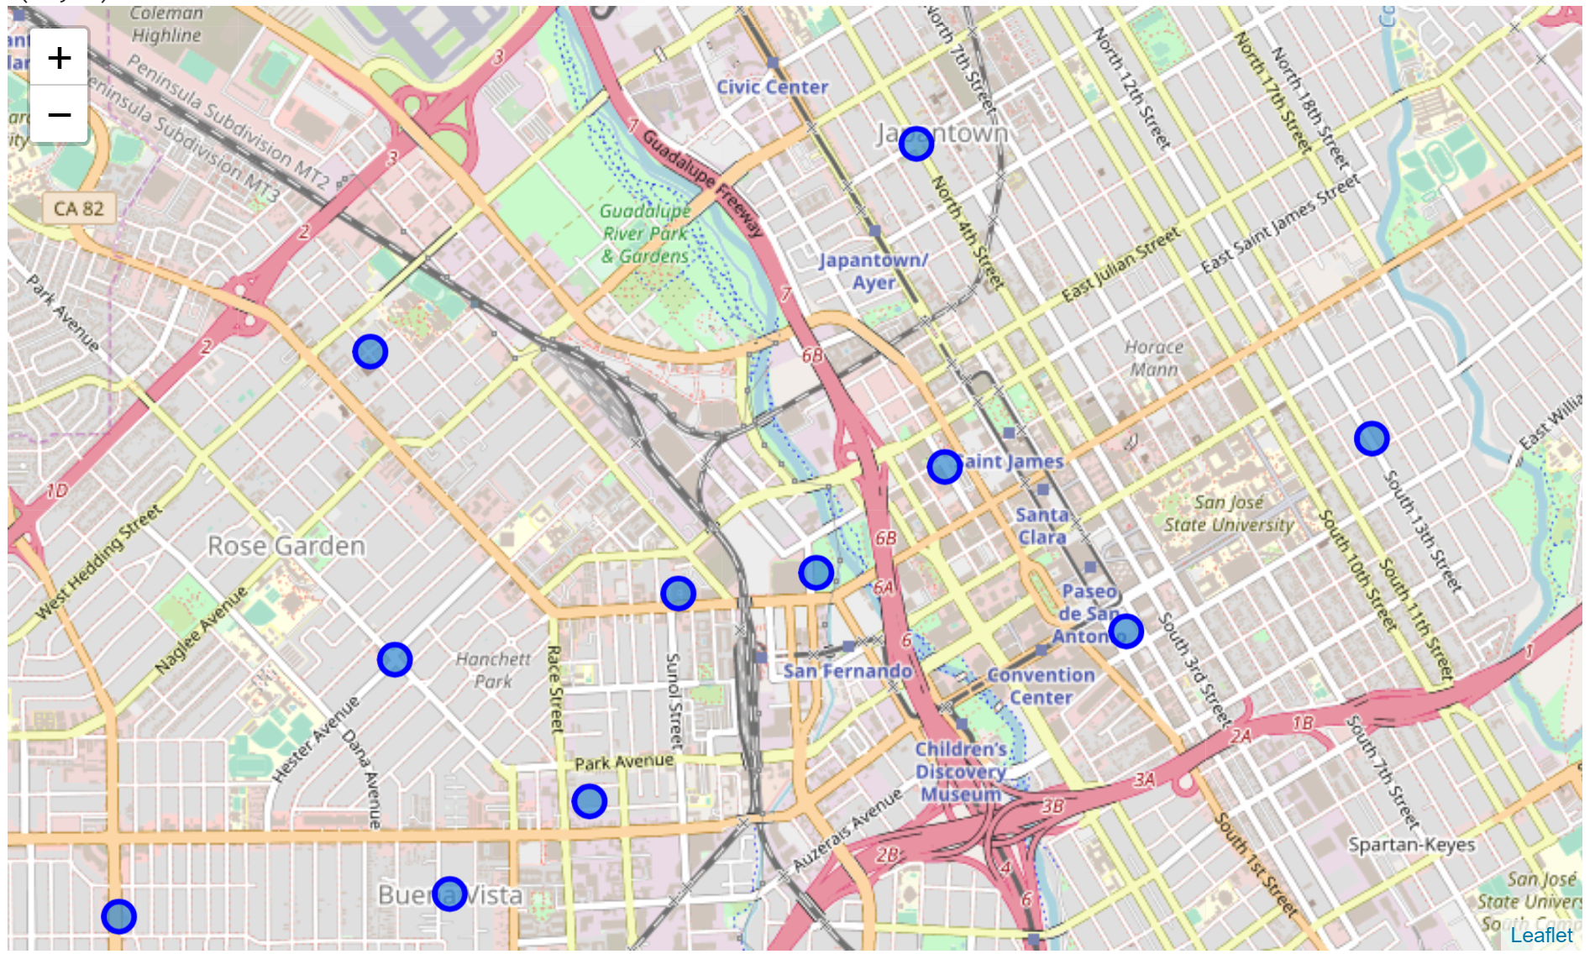
Methodology
After redundant neighborhoods are removed

Slide 8
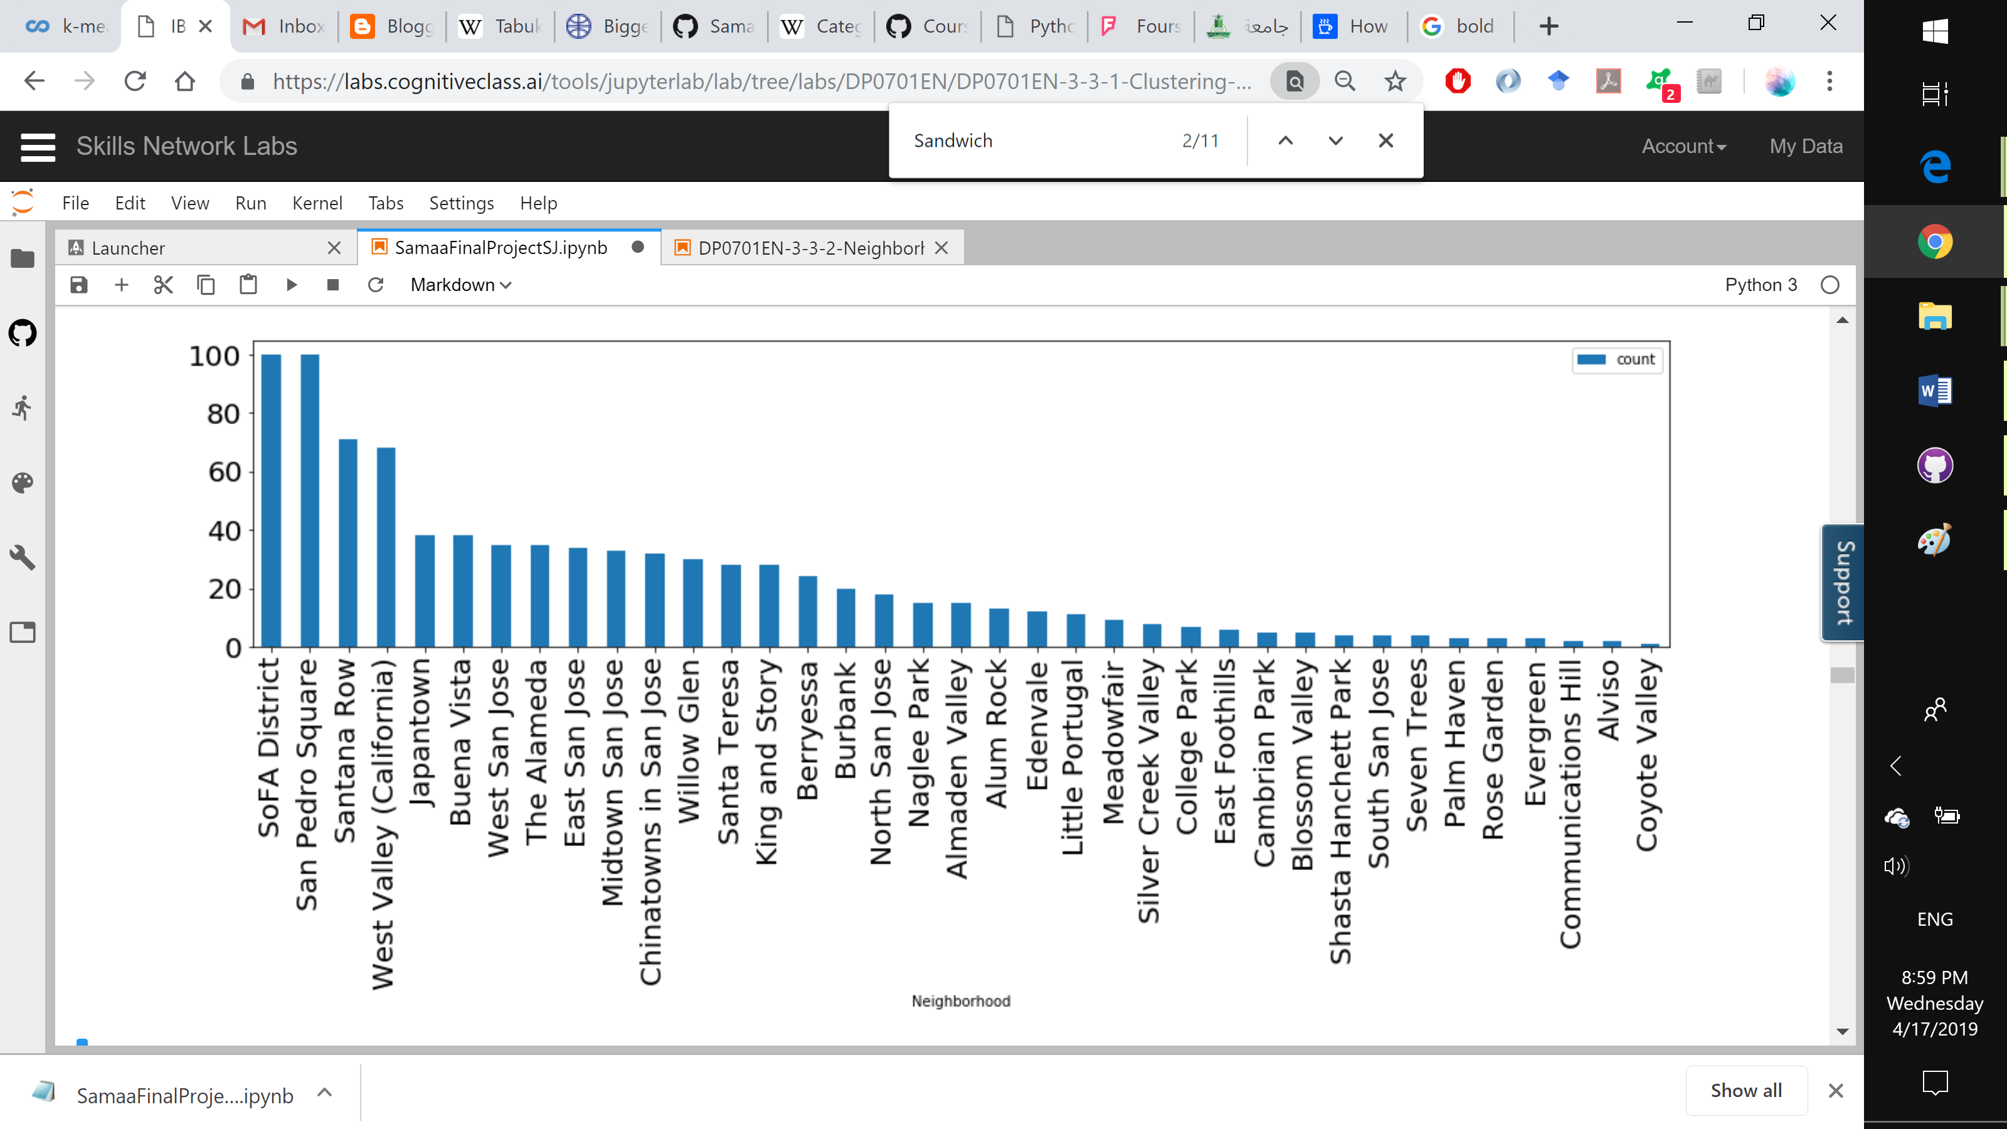
Methodology
Identify lively neighborhoods (neighborhoods with the most nearby venues

Slide 9
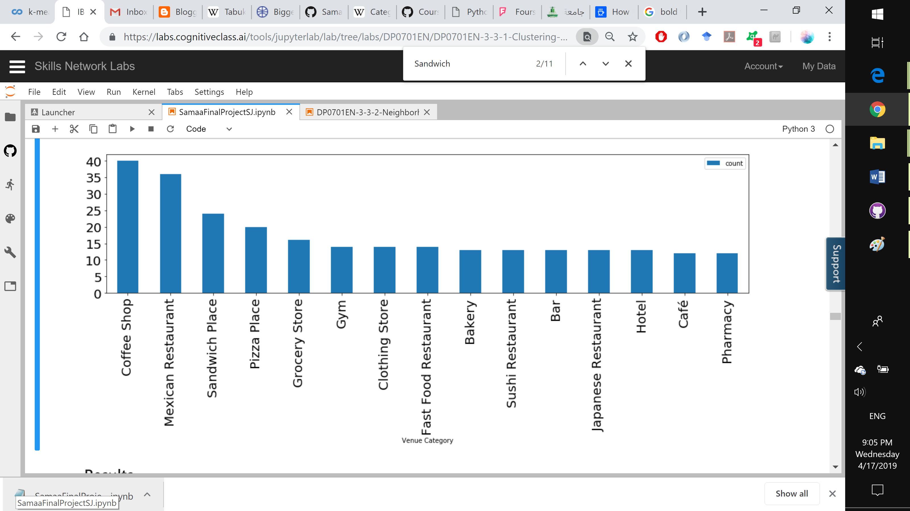
Methodology
Identify most frequent venue categories in San Jose

Slide 10
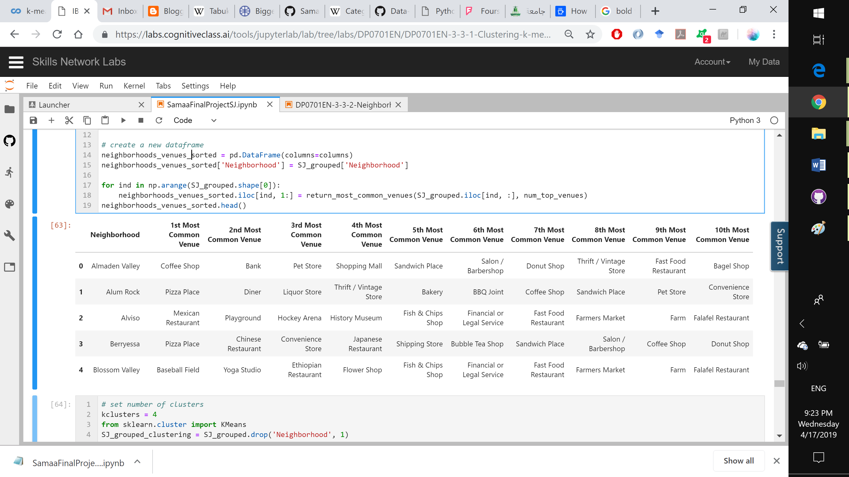
Methodology
Identify the most frequent venues per neighborhood

Slide 11
Results
Most lively neighborhoods:
Since our couple prefer lively neighborhoods, we focus one the top 10 neighborhoods in our recommendation
Most frequent venue category:
The results line up with what our couple prefer; ranking coffee shops and sandwich places in the top 3 venue categories.
Most frequent venues per neighborhood:
There are multiple venues that enlist coffee shops and sandwich places as their top frequent venues.

Slide 12
Results
One hot technique:
Each row represents a neighborhood
Each column represents a venue category
Values refer to whether a venue category occurs in a neighborhood
Clustering:
Why? No labels available nor are needed
K-means with k initialized to 4

Slide 13
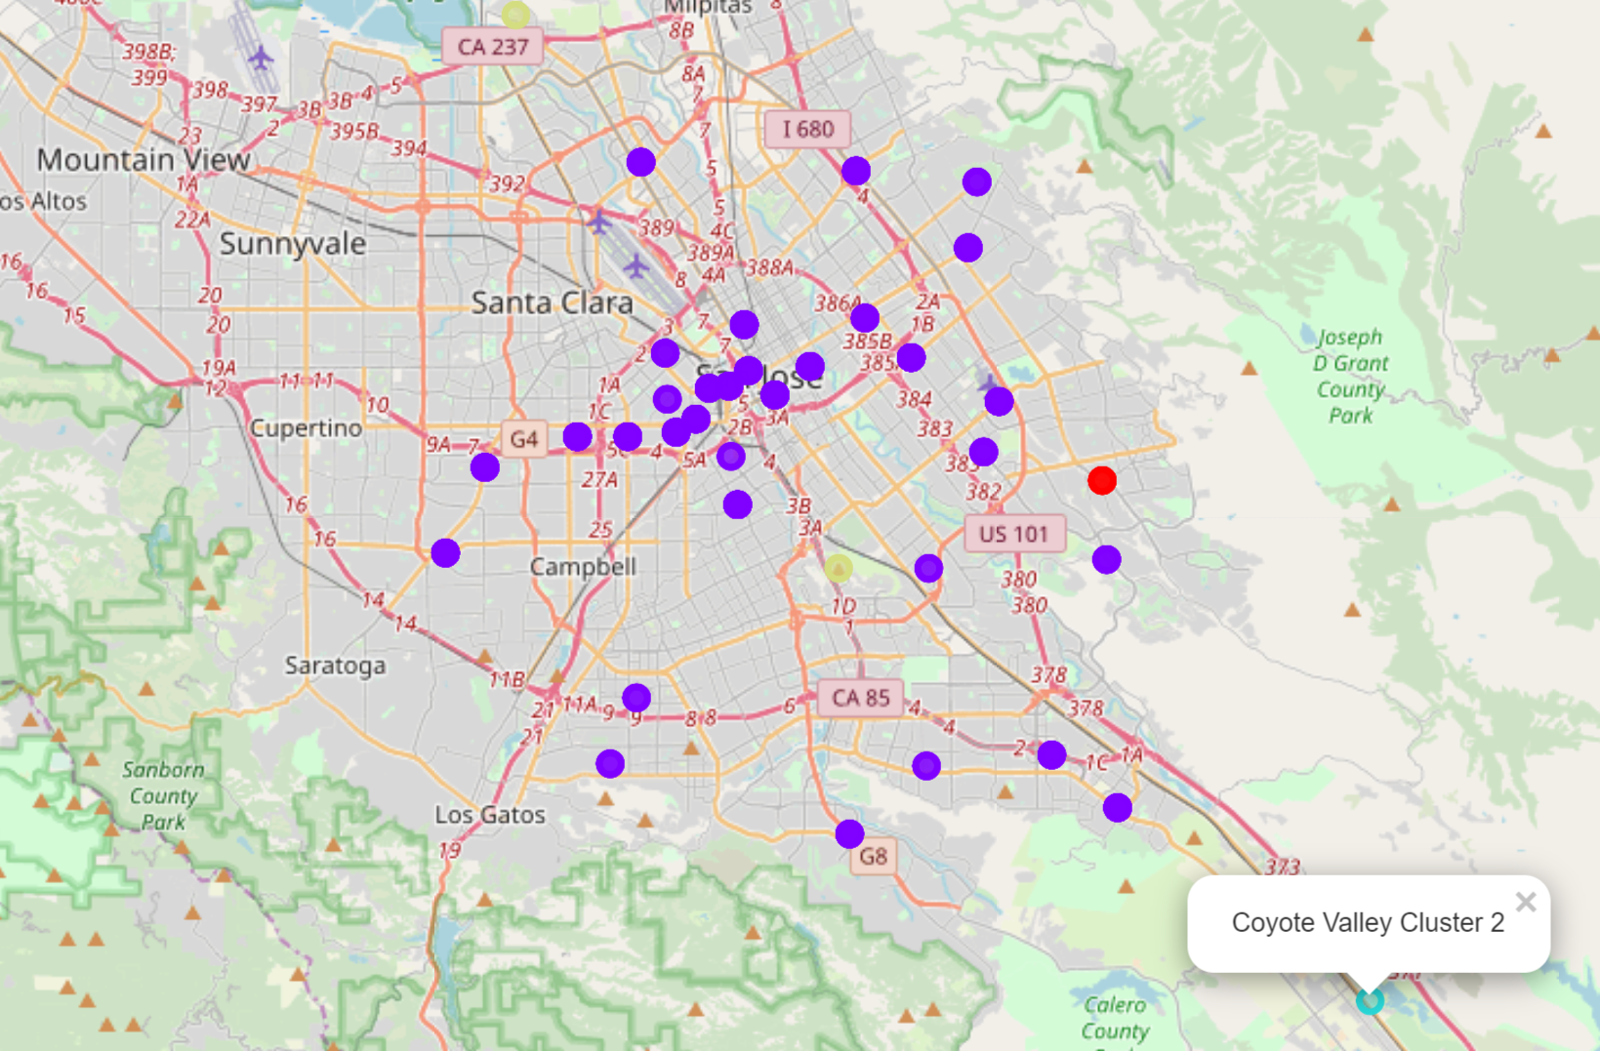
Results

Slide 14
Discussion
Most of San Jose's neighborhoods are very similar when it comes to nearby venues.
The two unique areas detected were the Coyote Valley on the very south end of San Jose and the Rose Garden area in the east.
Can be labeled as rural or could be considered suburbs of San Jose.

Slide 15
Discussion
Recommendations:
Strongly encourage moving in to San Jose.
Frequent and variety of venues
Most frequent venue include coffee shops and sandwich locations
in The Alameda, Naglee Park and San Pedro Square
San Pedro Square
Greatest number of venues.
Variety of coffee shops and sandwich places

Slide 16
Conclusion
The problem at hand was revolving around recommending the best location for living to a new couple moving to San Jose.
The preferences were a lively area where lots of coffee shops and sandwich venues can be found.
Data detailing the neighborhoods of San Jose was scrapped off of Wikipedia along with its latitude and longitude information.
In addition, Foursquare API was utilized in acquiring close by venues in regard to each neighborhood.
We employed multiple techniques in our approach to clean and prepare the data.
Furthermore, we took advantage of clustering algorithms in gaining knowledge about San Jose neighborhoods.
Finally, we were able to draw great conclusions and recommend the best fit neighborhoods based on the preferences given and the knowledge gained from the process.

Slide 17
References
[1] New State Residents Statistics, Demographic Data. Retrieved April 4, 2019, from https://www.governing.com/gov-data/residents-moving-to-new-state-demographics-population-statistics.html
[2] Category:Neighborhoods in San Jose, California. (2017, November 15). Retrieved April 4, 2019, from https://en.wikipedia.org/wiki/Category:Neighborhoods_in_San_Jose,_California

